Slide 1
Red-Black Trees
CMSC 420

Slide 2

Resources
We will be discussing “left-leaning” Red-Black Binary Search Trees.
Sedgewick & Wayne are a great resource (chapter 3.3).
Slides’ programming model based on theirs.

Slide 3
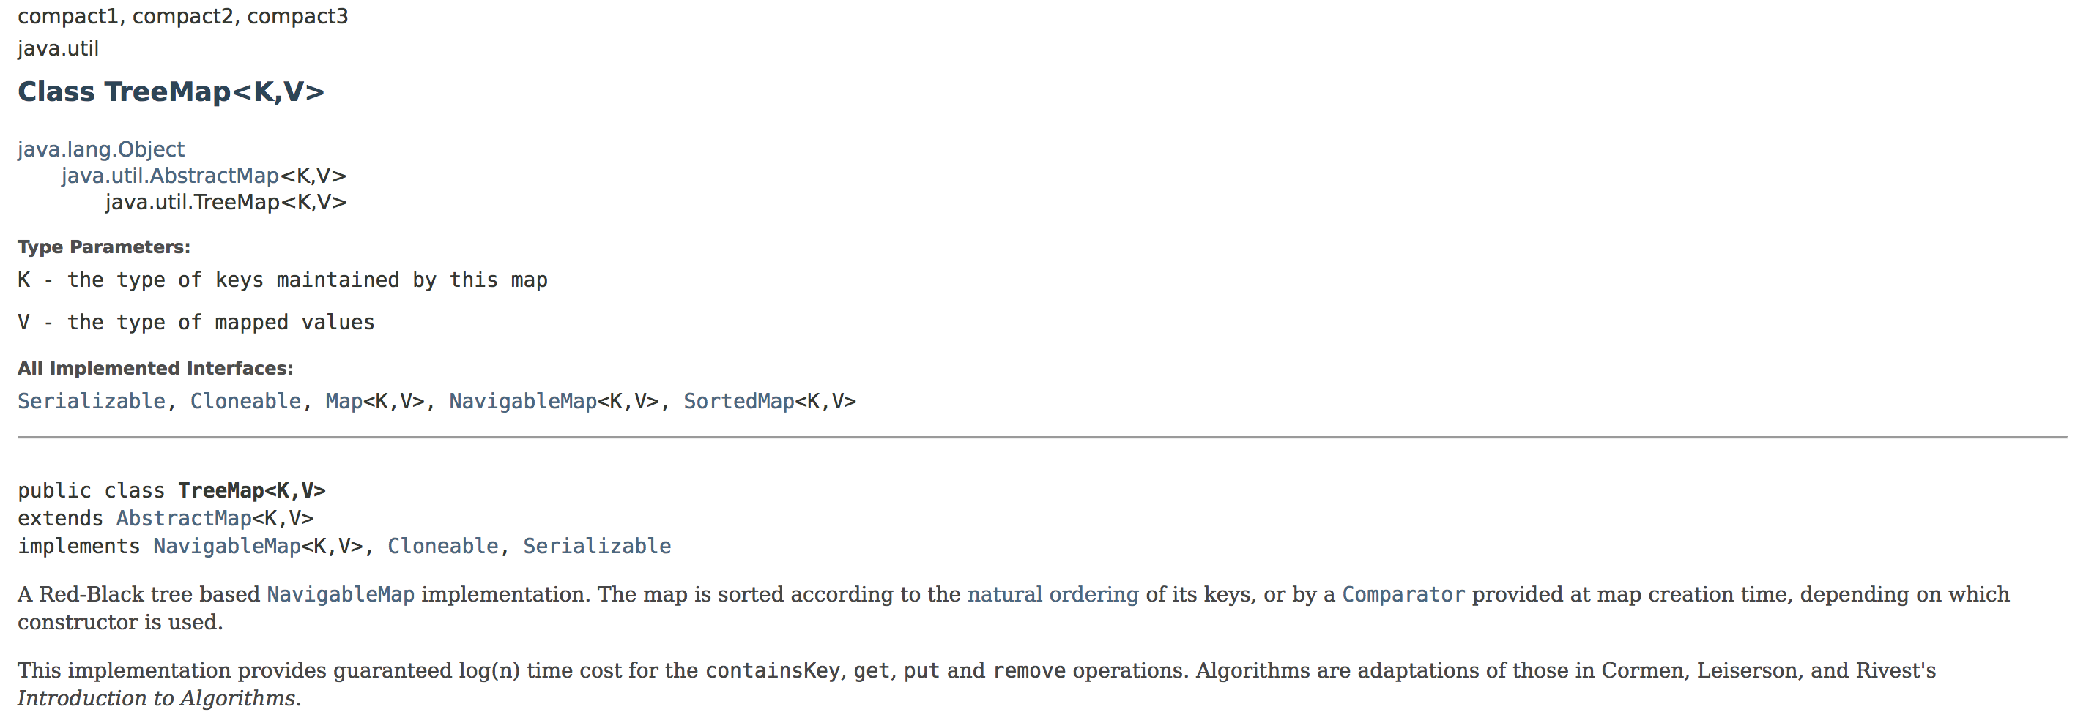
java.util.TreeMap

Slide 4

The Treemap

Slide 5
Utility
We will implement 2-3 trees with a binary tree!
So we get search and the top-down parts of insertion and deletion for free.
So we also get the top-down parts of insertion and deletion for free!
Idea: We will use red links to represent 3-nodes, and black links to represent the regular links between the nodes in a 2-3-Tree.
It helps Jason to imagine those as some sort of superglue.

Slide 6
Caveats
We will be talking about so-called “Left-leaning” Red-Black Trees.
Those are easier to implement than “traditional” Red-Black Trees and maintain the same theoretical properties.
Red-Black Trees do not implement 2-3 tree key rotations!
That is, when a node overflows or underflows, the relevant 2-3 tree would “explode” (resp. “vanish”) the node without looking at its siblings for space to hold a key.

Slide 7
Caveats
We will not talk about “hard” deletion from a Red-Black Tree.
“Soft” deletion: Also known as “Mark-and-sweep”. Mark nodes “dead” by setting a bit, and at periodic intervals, build a new tree by traversing the existing tree and inserting only the “live” nodes into the new tree.
ArrayLists do mark-and-sweep!
“Hard” deletion: our familiar semantics: actual key or node removal from the structure.
Very hard in RBBSTs, and actually allows for key rotations (which we have learned in 2-3 trees)

Slide 8
Representation
2-3 Tree
Red-Black Tree
15, 30
10
20
32, 39

Slide 9
Representation
2-3 Tree
Red-Black Tree
15, 30
10
20
32, 39
10
20
2-nodes transferred as they were.

Slide 10
Representation
2-3 Tree
Red-Black Tree
15, 30
15, 30
Pointers transferred as black pointers!
10
20
32, 39
10
20
32, 39

Slide 11

Representation
2-3 Tree
Red-Black Tree
30
15, 30
15
While 3-nodes are implemented as left-leaning red links!
39
32
10
20
10
20
32, 39

Slide 12
Representation
2-3 Tree
Red-Black Tree
30
15, 30
15
While 3-nodes are implemented as left-leaning red links!
39
32
10
20
10
20
32, 39
The result is a binary tree over keys!

Slide 13
Representation
2-3 Tree
Red-Black Tree
30
15, 30
15
null links are also black (they exist, unlike in threaded BSTs)
39
32
10
20
10
20
32, 39

Slide 14
Representation
2-3 Tree
Red-Black Tree
root
root
30
15, 30
15
And the root of the tree is also black.
39
32
10
20
10
20
32, 39

Slide 15
An immediate benefit of RBBSTs

Slide 16
An immediate benefit of RBBSTs
You can use existing BST code with virtually no modification!
Particularly for searches!
In fact, it makes a lot of sense to override an existing BST class
You would then need to make any inner node classes in the BST class protected

Slide 17
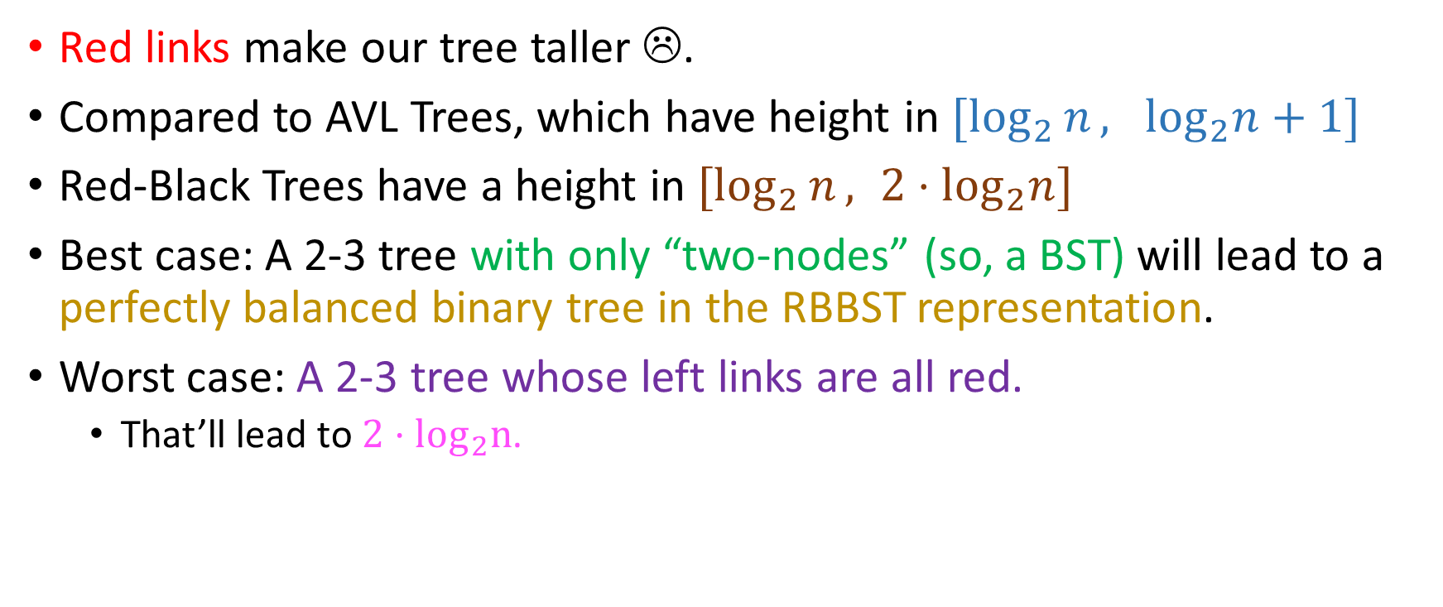
An immediate drawback
Red links make our tree taller ☹.
Compared to AVL Trees, which have height in $[\log_{2}{n}, \log_{2}n+1]$
Red-Black Trees have a height in $[\log_{2}{n}, 2⋅\log_{2}n]$
Best case: A 2-3 tree with only “two-nodes” (so, a BST) will lead to a perfectly balanced binary tree in the RBBST representation.
Worst case: A 2-3 tree whose left links are all red.
That’ll lead to $2⋅\log_{2}n$.

Slide 18
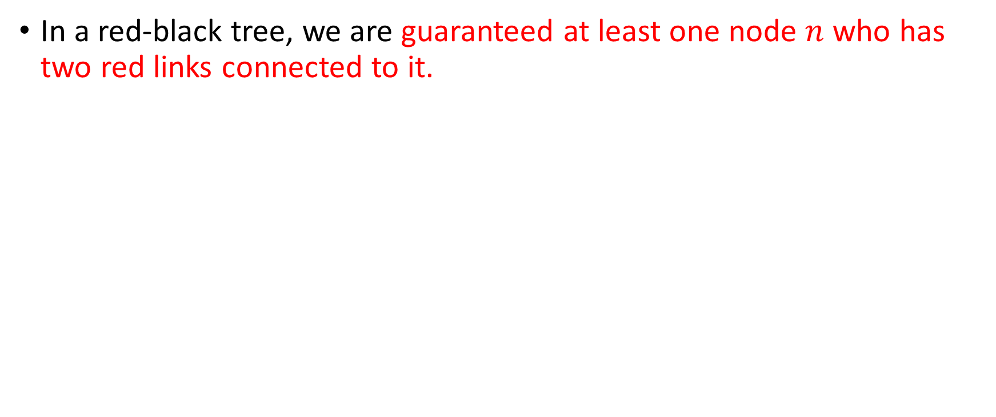
Quiz for you
In a red-black tree, we are guaranteed at least one node $n$ who has two red links connected to it.
True
False
15, 30
30
15
39
32, 39
32
10
20
10
20

Slide 19
Quiz for you
In a red-black tree, we are guaranteed at least one node $n$ who has two red links connected to it.
In fact, we have the opposite guarantee: there are no nodes that are linked to by 2 red links.
True
False
15, 30
30
15
39
32, 39
32
10
20
10
20

Slide 20
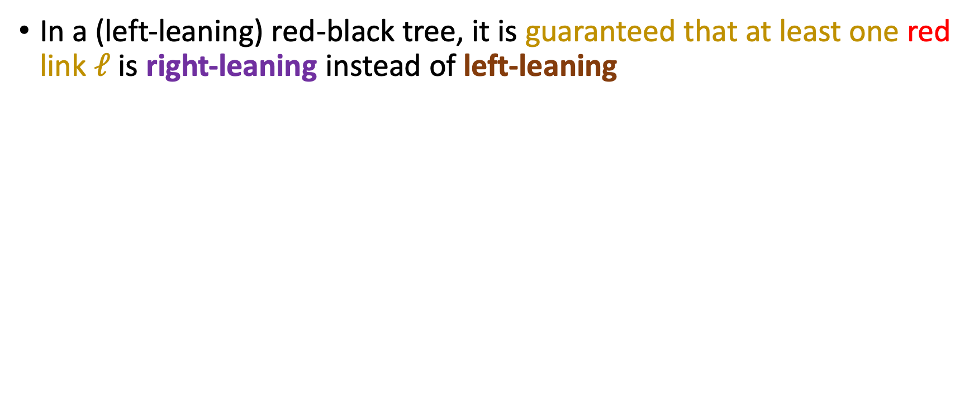
Another quiz for you
In a (left-leaning) red-black tree, it is guaranteed that at least one red link $ℓ$ is right-leaning instead of left-leaning
True
False
15, 30
30
15
39
32, 39
32
10
20
10
20

Slide 21

Another quiz for you
In a (left-leaning) red-black tree, it is guaranteed that at least one red link $ℓ$ is right-leaning instead of left-leaning
No right-leaning red links in an RBBST!
True
False
15, 30
30
15
39
32, 39
32
10
20
10
20

Slide 22
Node structure
We need:
Links to our children
Data field (some Comparable type T)
A flag that tells us what the color of the link from our parent to the current node is!
For its implementation to be visible in subclasses

Slide 23
Node structure
We need:
Links to our children
Data field (some Comparable type T)
A flag that tells us what the color of the link from our parent to the current node is!
For its implementation to be visible in subclasses
protected enum Color{
RED, BLACK;
}
protected class Node {
Node left, right;
T data;
Color color;
}

Slide 24
Node structure
We need:
Links to our children
Data field (some Comparable type T)
A flag that tells us what the color of the link from our parent to the current node is!
For its implementation to be visible in subclasses
protected enum Color{
RED, BLACK;
}
protected class Node {
Node left, right;
T data;
Color color;
}
This could work! ☺

Slide 25

Implement a utility
During our operations, we will sometimes have right-leaning red links temporarily.
$$r$$
protected enum Color {
RED, BLACK;
}
protected class Node {
Node left, right;
T data;
Color color;
}
15
30
1

Slide 26

Implement a utility
During our operations, we will sometimes have right-leaning red links temporarily.
$$r$$
$$r$$
30
protected enum Color {
RED, BLACK;
}
protected class Node {
Node left, right;
T data;
Color color;
}
15
30
15
1
1
In your notes, write a private method called rotateLeft(Node n) such that when we call r = rotateLeft(r), the result is as shown on the right!

Slide 27


Implement a utility
$$r$$
$$r$$
private enum Color{
RED, BLACK;
}
protected class Node {
Node left, right;
T data;
Color color;
}
private Node rotateLeft(Node n){
Node temp = n.right;
n.right = temp.left; // How do I know that temp != null?
temp.left = n;
temp.left.color = RED;
return temp;
}
15
30
30
15
1
1

Slide 28
Implement a utility
$$r$$
$$r$$
private enum Color{
RED, BLACK;
}
protected class Node {
Node left, right;
T data;
Color color;
}
private Node rotateLeft(Node n){
Node temp = n.right;
n.right = temp.left; // How do I know that temp != null?
temp.left = n;
temp.left.color = RED;
return temp;
}
15
30
30
15
1
1
rotateRight() symmetric.

Slide 29
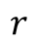
Implement another utility
Sometimes, during our operations, we will end up with a node connected to two red links.
$$r$$
protected enum Color{
RED, BLACK;
}
protected class Node {
Node left, right;
T data;
Color color;
}
15
1
30

Slide 30
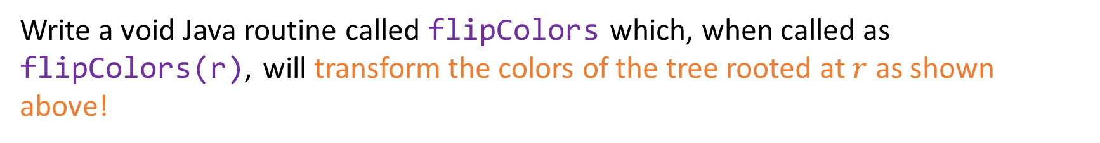
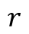
Implement another utility
Sometimes, during our operations, we will end up with a node connected to two red links.
$$r$$
$$r$$
protected enum Color{
RED, BLACK;
}
protected class Node {
Node left, right;
T data;
Color color;
}
15
15
1
30
1
30
Write a void Java routine called flipColors which, when called as
flipColors(r), will transform the colors of the tree rooted at $r$ as shown above!

Slide 31
Implement another utility
Sometimes, during our operations, we will end up with a node connected to two red links.
$$r$$
$$r$$
protected enum Color{
RED, BLACK;
}
protected class Node {
Node left, right;
T data;
Color color;
} protected void flipColors(Node n){
n.left.color = n.right.color = BLACK; n.color = RED;
}
15
15
1
30
1
30

Slide 32

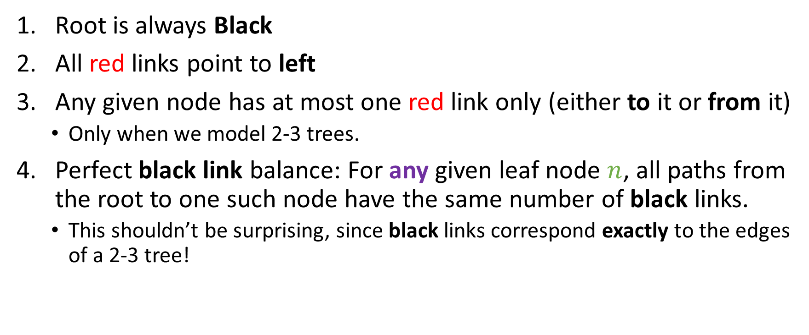
Red-Black Tree Invariants
Root is always Black
All red links point to left
Any given node has at most one red link only (either to it or from it)
Only when we model 2-3 trees.
Perfect black link balance: For any given leaf node $n$, all paths from the root to one such node have the same number of black links.
This shouldn’t be surprising, since black links correspond exactly to the edges of a 2-3 tree!

Slide 33
Maintaining our invariants
Root is always Black
After every insertion, we will make sure the last call will be explicitly making the root black!
All red links point to left
If we create a fresh node which is connected to its parent with a red link, but it’s the parent’s right child, we will rotate the parent left to make the red link point to the left

Slide 34
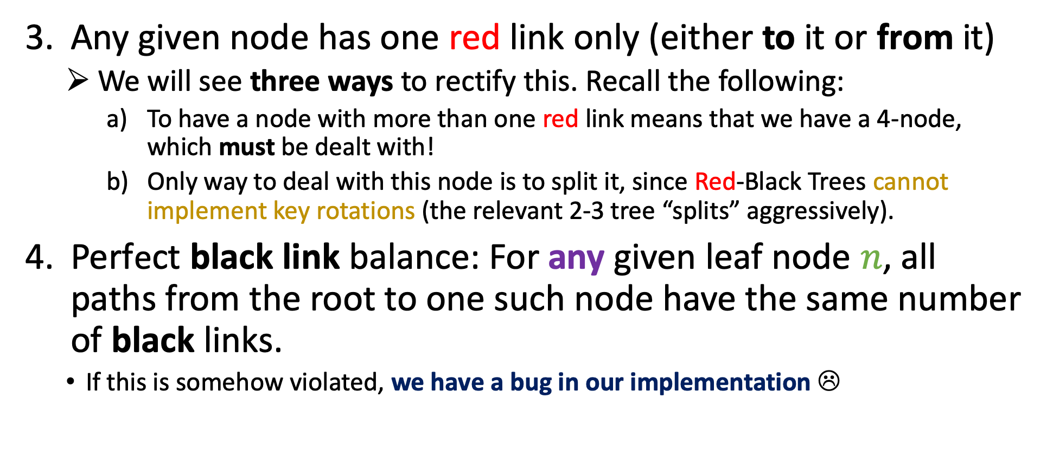
Maintaining our invariants
Any given node has one red link only (either to it or from it)
We will see three ways to rectify this. Recall the following:
To have a node with more than one red link means that we have a 4-node, which must be dealt with!
Only way to deal with this node is to split it, since Red-Black Trees cannot implement key rotations (the relevant 2-3 tree “splits” aggressively).
Perfect black link balance: For any given leaf node $n$, all paths from the root to one such node have the same number of black links.
If this is somehow violated, we have a bug in our implementation ☹

Slide 35
Insertion
2-3 tree
Red-Black tree

Slide 36
Insertion
2-3 tree
Red-Black tree
root
root
X
X

Slide 37
Insertion
2-3 tree
Red-Black tree
root
root
55
55

Slide 38
Insertion
2-3 tree
Red-Black tree
root
root
55
80
55, 80

Slide 39
Insertion
2-3 tree
Red-Black tree
root
root
Must rotate left!
55
80
55, 80

Slide 40
Insertion
2-3 tree
Red-Black tree
root
root
55
80
55, 80

Slide 41
Insertion
2-3 tree
Red-Black tree
root
root
55
80
55, 80, 90

Slide 42
Insertion
2-3 tree
Red-Black tree
root
root
55
80
55, 80, 90
90
We always connect fresh nodes to their parents with a red link!

Slide 43
Insertion
2-3 tree
Red-Black tree
root
root
55
80
80
90
55
90
flipcolors() is used to exchange the link colors to represent the new 2-nodes…

Slide 44
Insertion
2-3 tree
Red-Black tree
root
root
55
80
80
90
55
90
flipcolors() is used to exchange the link colors to represent the new 2-nodes… But the root node of an RBBST can never really be red, so we explicitly make it black at that level of the recursion.

Slide 45
Insertion
2-3 tree
Red-Black tree
root
root
55
80
80
90
55
90
flipcolors() is used to exchange the link colors to represent the new 2-nodes… But the root node of an RBBST can never really be red, so we explicitly make it black at that level of the recursion.

Slide 46
Insertion
2-3 tree
Red-Black tree
root
root
55
80
80
90
55
90
flipcolors() is used to exchange the link colors to represent the new 2-nodes… But the root node of an RBBST can never really be red, so we explicitly make it black at that level of the recursion.
public void insert(Key key){
root = insert(root, key);
root.color = BLACK;
}

Slide 47
Insertion
2-3 tree
Red-Black tree
root
root
80
80
55
90
55
85, 90
85

Slide 48
Insertion
2-3 tree
Red-Black tree
root
root
80
80
55
90
55
85, 90
85
3-node! That’s normal! ☺

Slide 49
Insertion
2-3 tree
Red-Black tree
root
root
80
80
55
90
55, 66
85, 90
85
66

Slide 50
Insertion
2-3 tree
Red-Black tree
root
root
80
80
55
90
55, 66
85, 90
85
66

Slide 51
Insertion
2-3 tree
Red-Black tree
root
root
80
80
55
90
55, 66
85, 90
85
66
Gotta rotate!

Slide 52
Insertion
2-3 tree
Red-Black tree
root
root
80
80
55
90
55, 66
85, 90
85
66
Gotta rotate!

Slide 53
Insertion
2-3 tree
Red-Black tree
root
root
80
80
66
90
55, 66
85, 90
55
85

Slide 54
Insertion
2-3 tree
Red-Black tree
root
root
80
80
66
90
55, 66
85, 90
55
85
Let’s examine three cases for an insertion on this 3-node!

Slide 55
Insertion
2-3 tree
Red-Black tree
Insert 70
root
root
80
80
66
90
55, 66
85, 90
55
85

Slide 56
Insertion
2-3 tree
Red-Black tree
Insert 70
root
root
80
80
66
90
55, 66, 70
85, 90
55
85
70

Slide 57
Insertion
2-3 tree
Red-Black tree
Insert 70
root
root
80
80
66
90
55, 66, 70
85, 90
55
85
70
Overflow! ☹
flipColors()! ☺

Slide 58
Insertion
2-3 tree
Red-Black tree
Insert 70
root
root
80
80
66
90
66
85, 90
55
85
55
70
70
Overflow
flipColors()!

Slide 59
Insertion
2-3 tree
Red-Black tree
Insert 70
root
root
66, 80
80
85, 90
66
90
55
70
55
85
70

Slide 60
Insertion
2-3 tree
Red-Black tree
Insert 70
root
root
66, 80
80
85, 90
66
90
55
70
55
85
70
So, this case, where we insert a key as the biggest key of a temporary 4-node, was rectified with one call to flipColors().
Notice the perfect black link balance of the Red-Black Tree?

Slide 61
Insertion
2-3 tree
Red-Black tree
Insert 40
root
root
80
80
66
90
55, 66
85, 90
55
85

Slide 62
Insertion
2-3 tree
Red-Black tree
Insert 40
root
root
80
80
66
90
40, 55, 66
85, 90
55
85
40

Slide 63
Insertion
2-3 tree
Red-Black tree
Insert 40
root
root
80
80
55
90
40, 55, 66
85, 90
85
40
66

Slide 64
Insertion
2-3 tree
Red-Black tree
Insert 40
root
root
80
55, 80
Color Flipping
55
40
90
66
85, 90
40
66
85

Slide 65
Insertion
2-3 tree
Red-Black tree
Insert 40
root
root
80
55, 80
Color Flipping
55
40
90
66
85, 90
40
66
85
So in this case (inserting as a temporary 4 node’s least key), we need 1 rotation and one color flipping!

Slide 66
Insertion
2-3 tree
Red-Black tree
Insert 60
root
root
80
80
66
90
55, 66
85, 90
55
85

Slide 67
Insertion
2-3 tree
Red-Black tree
Insert 60
root
root
80
80
66
90
55, 60, 66
85, 90
55
85
60

Slide 68
Insertion
2-3 tree
Red-Black tree
Insert 60
root
root
80
80
66
90
55, 60, 66
85, 90
60
55
85

Slide 69
Insertion
2-3 tree
Red-Black tree
Insert 60
root
root
80
80
66
90
60
85, 90
60
55
85
55
66

Slide 70
Insertion
2-3 tree
Red-Black tree
Insert 60
root
root
80
80
60
55
90
60
85, 90
85
66
55
66

Slide 71

Insertion
2-3 tree
Red-Black tree
Insert 60
root
root
Color flipping
80
60, 80
60
55
90
55
66
85, 90
85
66
In this final case (inserting as a temporary 4 node’s middle key), we need 2 rotations and one color flipping!

Slide 72
Exercise for you!
2-3 tree
Red-Black tree
root
root
60, 80
80
60
55
90
55
66
85, 90
85
66
Please go ahead and insert 87 for me please! ☺

Slide 73
Exercise for you!
2-3 tree
Red-Black tree
root
root
60, 80
80
60
55
90
55
66
85, 90
85
66
Remember: In Red-Black trees, we can’t model key rotations! We will split the yellow node!

Slide 74
Exercise for you!
2-3 tree
Red-Black tree
root
root
60, 80
80
60
90
55
66
85, 87, 90
55
66
85
87

Slide 75
Exercise for you!
2-3 tree
Red-Black tree
root
root
60, 80
80
60
55
90
55
66
85, 87, 90
66
87
85

Slide 76
Exercise for you!
2-3 tree
Red-Black tree
root
root
60, 80
80
60
55
87
55
66
87
66
85
90
85
90

Slide 77
Exercise for you!
2-3 tree
Red-Black tree
root
root
60, 80, 87
80
60
Color flip
55
87
55
66
85
90
66
85
90

Slide 78
Exercise for you!
2-3 tree
Red-Black tree
root
root
Color flip
80
80
60
60
87
55
87
66
85
90
55
66
85
90

Slide 79
Exercise for you!
2-3 tree
Red-Black tree
root
root
Don’t forget to
set the root to BLACK!
Color flip
80
80
60
60
87
55
87
66
85
90
55
66
85
90

Slide 80
Exercise for you!
2-3 tree
Red-Black tree
root
root
Don’t forget to
set the root to BLACK!
Color flip
80
80
60
60
87
55
87
66
85
90
55
66
85
90
public void insert(Key key){
root = insert(root, key);
root.color = BLACK;
}
Speaking of…

Slide 81
Fill-in the insertion subroutine!
private Node insert(Node n, Key key){
if(n == null) return new Node(key, RED);
if(key.compareTo(n.key) < 0)
n.left = insert(n.left, key);
else if(key.compareTo(n.key) >= 0)
n. right = insert(n.right, key);
else return n;
if(isRed(n.right) && __________ ) n = rotateLeft(n);
if(isRed(n.left) && __________) n = rotateRight(n);
if(_______ && isRed(n.right)) __________;
}
boolean isRed(Node n){
if(n == null) return false;
else return (n.color == RED);

Slide 82

Fill-in the insertion subroutine!
private Node insert(Node n, Key key){
if(n == null) return new Node(key, RED);
if(key.compareTo(n.key) < 0)
n.left = insert(n.left, key);
else if(key.compareTo(n.key) >= 0)
n. right = insert(n.right, key);
else return n;
if(isRed(n.right) && _!isRed(n.left)___ ) n = rotateLeft(n);
if(isRed(n.left) && __isRed(n.left.left)____) n = rotateRight(n);
if(__isRed(n.left)_____ && isRed(n.right)) __flipColors(n)__;
}
boolean isRed(Node n){
if(n == null) return false;
else return (n.color == RED);

Slide 83

Problem 3!

Slide 84
“Hard” Deletion
By “hard” Deletion we refer to a process that actually removes the key’s wrapper, the node, from the tree.
We’ve already seen how to do this in threaded and non-threaded BSTs, AVL, Splay, 2-3 (conceptually).

Slide 85

“Hard” Deletion
By “hard” Deletion we refer to a process that actually removes the key’s wrapper, the node, from the tree.
We’ve already seen how to do this in threaded and non-threaded BSTs, AVL, Splay, 2-3 (conceptually).
Hard deletion in RBBSTs is way too hard and we will not cover it.
It relies on subroutines for deleting the minimum and maximum of a subtree.
Segdewick and Wayne show an implementation as an exercise in 3.3.

Slide 86
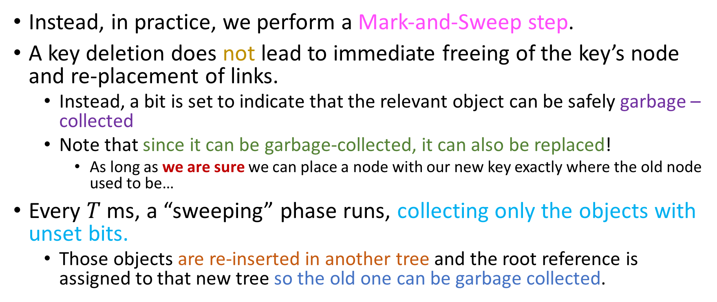
“Soft” deletion (Mark – and – Sweep)
Instead, in practice, we perform a Mark-and-Sweep step.
A key deletion does not lead to immediate freeing of the key’s node and re-placement of links.
Instead, a bit is set to indicate that the relevant object can be safely garbage – collected
Note that since it can be garbage-collected, it can also be replaced!
As long as we are sure we can place a node with our new key exactly where the old node used to be…
Every $T$ ms, a “sweeping” phase runs, collecting only the objects with unset bits.
Those objects are re-inserted in another tree and the root reference is assigned to that new tree so the old one can be garbage collected.

Slide 87
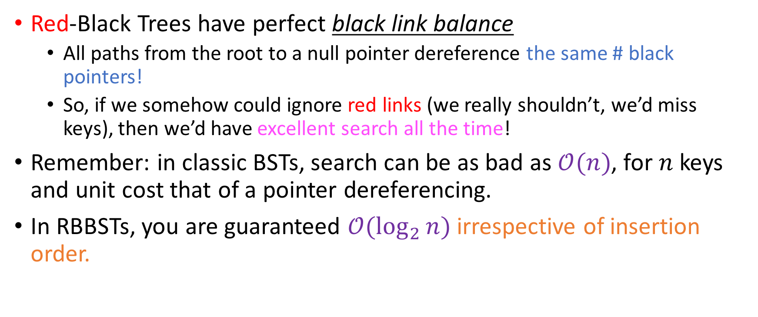
Some theory behind RBBSTs
Red-Black Trees have perfect black link balance
All paths from the root to a null pointer dereference the same # black pointers!
So, if we somehow could ignore red links (we really shouldn’t, we’d miss keys), then we’d have excellent search all the time!
Remember: in classic BSTs, search can be as bad as $𝒪(n)$, for $n$ keys and unit cost that of a pointer dereferencing.
In RBBSTs, you are guaranteed $𝒪(\log_{2}{n})$ irrespective of insertion order.

Slide 88

Some theory behind RBBSTs
Red-Black Trees have perfect black link balance
All paths from the root to a null pointer dereference the same # black pointers!
So, if we somehow could ignore red links (we really shouldn’t, we’d miss keys), then we’d have excellent search all the time!
Remember: in classic BSTs, search can be as bad as $𝒪(n)$, for $n$ keys and unit cost that of a pointer dereferencing.
In RBBSTs, you are guaranteed $𝒪(\log_{2}{n})$ irrespective of insertion order.

Slide 89
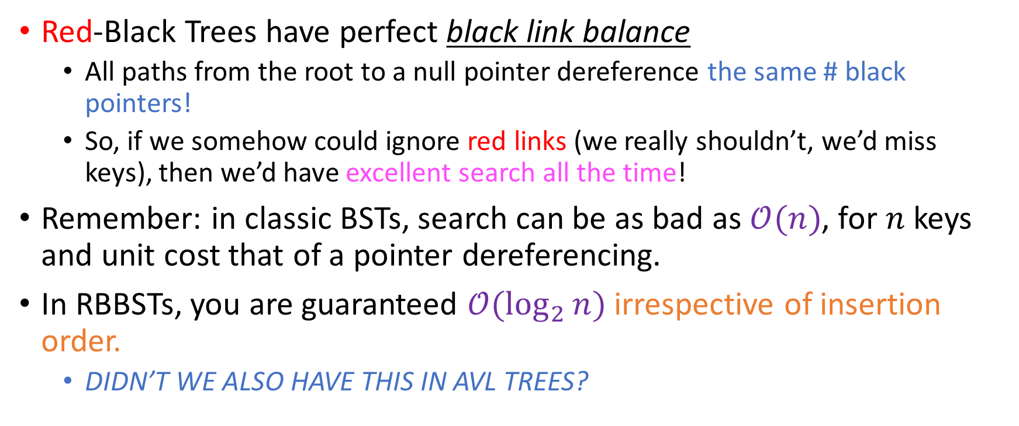
Some theory behind RBBSTs
Red-Black Trees have perfect black link balance
All paths from the root to a null pointer dereference the same # black pointers!
So, if we somehow could ignore red links (we really shouldn’t, we’d miss keys), then we’d have excellent search all the time!
Remember: in classic BSTs, search can be as bad as $𝒪(n)$, for $n$ keys and unit cost that of a pointer dereferencing.
In RBBSTs, you are guaranteed $𝒪(\log_{2}{n})$ irrespective of insertion order.
DIDN’T WE ALSO HAVE THIS IN AVL TREES?

Slide 90
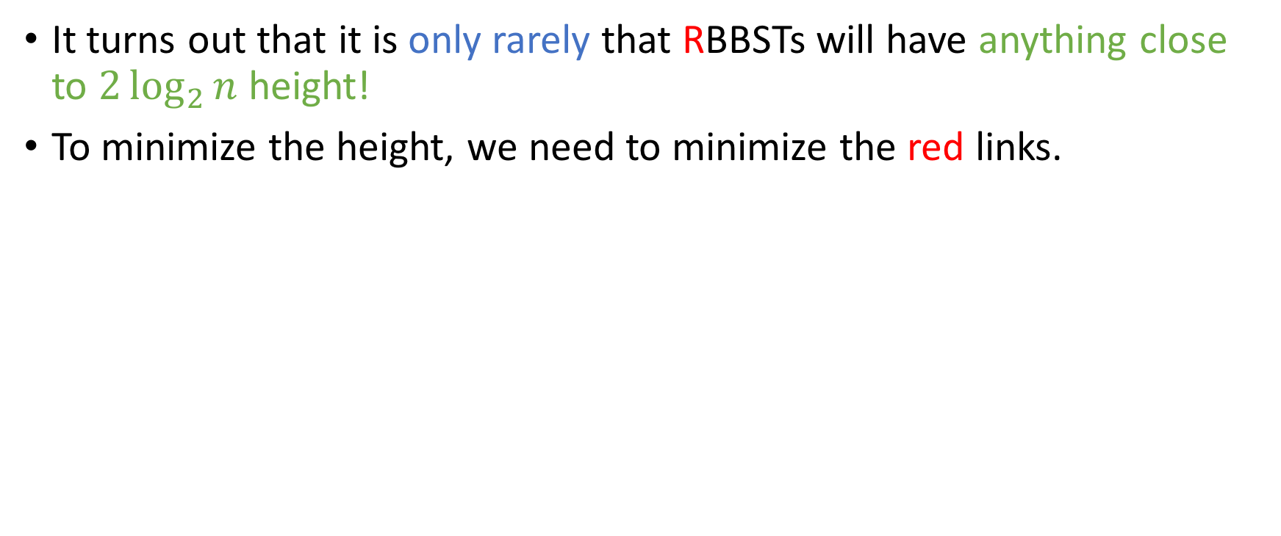
Some theory behind RBBSTs
It turns out that it is only rarely that RBBSTs will have anything close to $2\log_{2}{n}$ height!
To minimize the height, we need to minimize the red links.

Slide 91
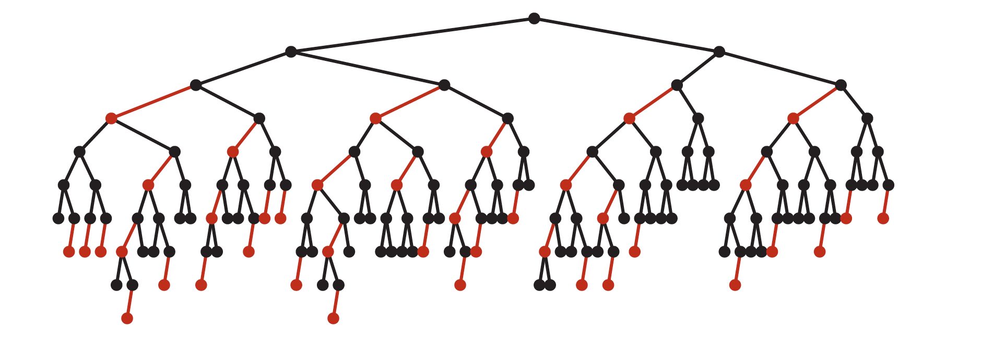
Average height in RBBSTs
Turns out that in practice, RBBSTs look more like this…

Slide 92
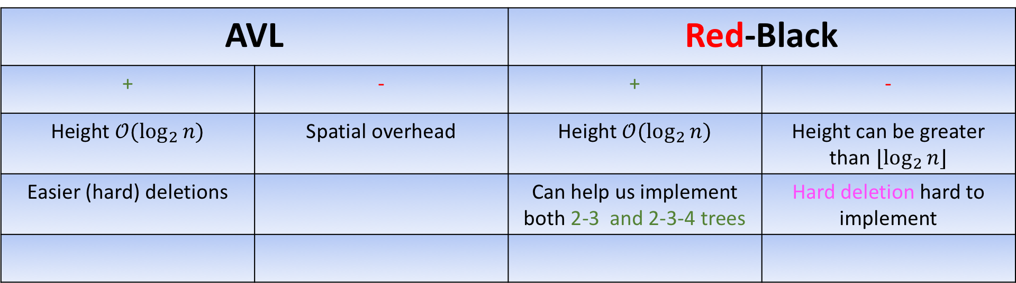
AVL vs Red-Black
AVL |  | Red-Black
+ | - | + | -
Height $𝒪(\log_{2}{n)}$ | Spatial overhead | Height $𝒪(\log_{2}{n)}$ | Height can be greater than $⌊\log_{2}{n}⌋$
Easier (hard) deletions |  | Can help us implement both 2-3 and 2-3-4 trees | Hard deletion hard to implement

